Slide 1

Deletion in BST
BCSC 0015 Applied Data Structures and Algorithms

Slide 2
Deletion in BST
Means removing a node from the tree
There are 3 cases for deletion
Case 1 : deleting a leaf
Case 2 : deleting a node with one child
Case 3 : deleting a node with two children
BCSC 0015 Applied Data Structures and Algorithms

Slide 3
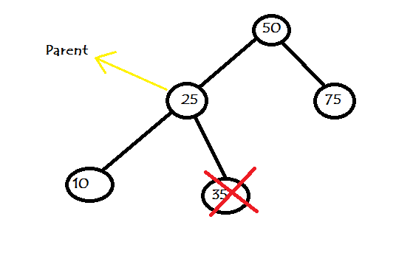
Case 1 : deleting a leaf
It’s a simplest form of delete.
In this we will set the parent reference to “null”.
BCSC 0015 Applied Data Structures and Algorithms

Slide 4
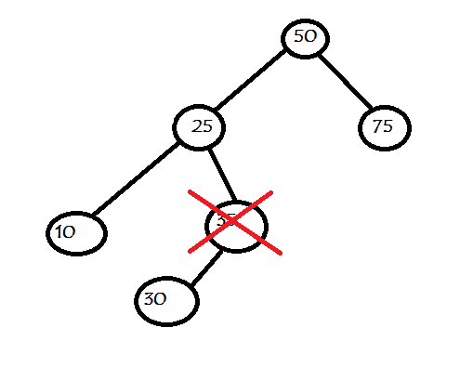
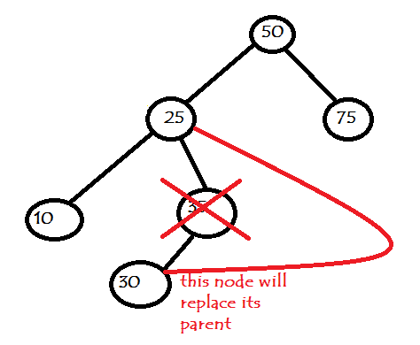
Case 2 : deleting a node with one child
In this, the deleting node will be replaced by its child.
The deleting node can have left or right child
BCSC 0015 Applied Data Structures and Algorithms

Slide 5
Case 3 : deleting a node with two children
A bit complicated case.
You have to find successor of deleting node.
Successor of any node, will be its in-order successor.
On successor you have to perform delete, as successor will be remove from its current position.
BCSC 0015 Applied Data Structures and Algorithms

Slide 6
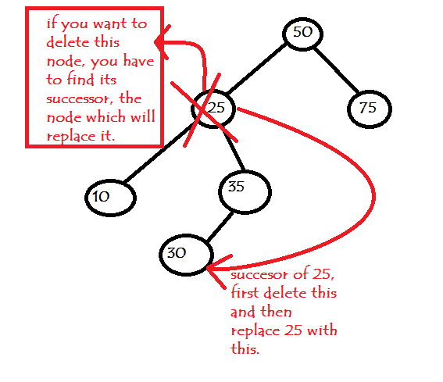
Case 3 : deleting a node with two children
Successor can be a leaf node, or it can have 1 right child.
BCSC 0015 Applied Data Structures and Algorithms

Slide 7
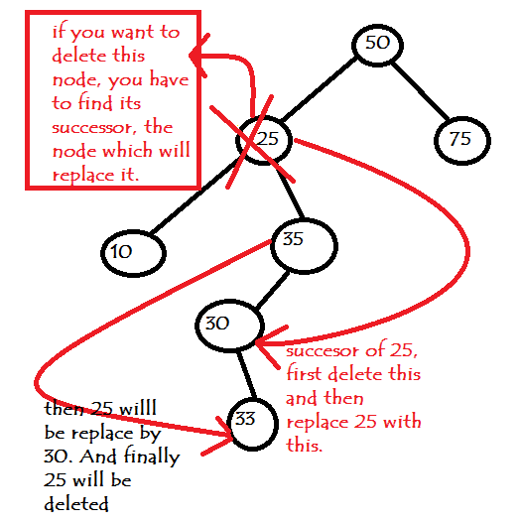
Case 3 : deleting a node with two children
BCSC 0015 Applied Data Structures and Algorithms

